Slide 1

Session Integrity Firewall (SIF)
SRM INSTITUTE OF SCIENCE AND TECHNOLOGY
SCHOOL OF COMPUTING
DEPARTMENT OF NETWORKING AND COMMUNICATIONS
21CSP302L – MINOR PROJECT
Batch ID: NWCMP141
Aryaman Chaudhary (RA2311030010222)
Smita Joshi (RA2311030010232)
Upanshu Pandey (RA2311030010248)
Guide name: Dr. Joseph Raymond
Designation: Assistant Professor Department: NWC

Slide 2
Introduction
Modern web applications rely on login-based authentication
After login, session tokens (JWT/cookies) are trusted until expiry
No continuous verification during active sessions
Vulnerable to:
-Session hijacking
-Token replay attacks
-Session fixation
-Credential sharing
Need for continuous session integrity validation
Proposed Solution: Session Integrity Firewall (SIF)
Application-layer middleware
Real-time session validation system

Slide 3
Literature Survey
S.No | Title (Journal, Authors, Year) | Methodology / Key Findings | Gaps & Limitations
1 | Popov, A., Nystrom, M., Balfanz, D. (2018). Token Binding Protocol Version 1.0. RFC 8471, IETF | Cryptographic binding of tokens to TLS sessions to prevent replay | Requires browser support; limited adoption
2 | Amira, A., Hammoudeh, M., et al. (2017). Sound and Static Analysis of Session Fixation. ACM Conference | Static analysis techniques to detect session fixation vulnerabilities | Focused on detection rather than prevention
3 | Juels, A., Brainard, J. (2012). Client-Side Defense Against Web Session Hijacking. ACM CCS | One-time cookie/token approaches to prevent replay attacks | Usability and scalability challenges
4 | Fett, D., Küsters, R., Schmitz, G. (2024). A Comprehensive Security Analysis of JSON Web Tokens. Journal of Web Security | Evaluated JWT misuse patterns and attack vectors | Does not provide runtime validation mechanisms
5 | Wiefling, S., Lo Iacono, L., et al. (2019). Risk-Based Authentication: Empirical Evaluation. IEEE Security & Privacy | Context-aware login risk scoring and adaptive authentication | Protection limited to login stage

Slide 4
Literature Survey
6 | Baig, A. F., et al. (2021). Continuous Authentication: A Survey. IEEE Access | Behavioral and biometric continuous authentication methods | High computational overhead
7 | Alaca, F., van Oorschot, P. (2016). Device Fingerprinting for Adaptive Authentication. ACM Workshop | Behavioral pattern and device fingerprinting for step-up authentication | Requires large behavioral datasets
8 | Nguyen, T., Reddi, V. (2023). RLAuth: Risk-Based Authentication Using Reinforcement Learning. IEEE Access | Reinforcement learning for adaptive authentication challenges | Complex training and deployment
9 | Wang, X., Zhao, Y. (2022). Keystroke Dynamics-Based Continuous Authentication. Sensors Journal | Behavioral biometrics for continuous identity verification | Behavioral drift affects accuracy
10 | Mondal, S., Bours, P. (2017). Continuous Authentication Using Mouse Dynamics. Pattern Recognition Letters | Multi-modal behavioral authentication improves accuracy | Privacy concerns

Slide 5
Literature Survey
11 | Soni, N., Patel, R. (2024). Performance and Security Tradeoffs of JWT. Journal of Network Security | Evaluated JWT performance-security balance | No anomaly detection mechanism
12 | Bhaturkar, P., et al. (2014). Prevention of Session Hijacking and IP Spoofing. IJCSMC Journal | Network-layer cryptographic defenses for session hijacking | Lack of application-layer controls
13 | Ryu, J., Lee, S. (2023). Adaptive Biometric Authentication Systems: Survey. Computers & Security | Adaptive biometric authentication models | Requires specialized hardware
14 | Campbell, B., Sakimura, N. (2018). OpenID Connect Token Bound Authentication. OpenID Foundation Spec | Token binding for identity federation security | Deployment complexity
15 | Sharma, K., Gupta, R. (2026). REST API Security Using JWT in Session Management. International Journal of Information Security | Practical JWT session management improvements | Focused on implementation rather than continuous validation

Slide 6
Research Gaps
Most systems validate users only during login.
Token binding solutions lack adoption and flexibility.
Behavioral continuous authentication introduces overhead and privacy concerns.
Risk-based authentication is mainly login-centric.
JWT security research focuses on implementation flaws rather than runtime misuse detection.
Limited middleware solutions for real-time session validation.
Lack of lightweight, deterministic risk engines for session monitoring.
Absence of modular frameworks that combine stateless authentication with stateful monitoring.

Slide 7
Problem Statement
Web applications trust session tokens completely after login
If token is stolen:
-Attacker gains full access
-No re-verification required
Leads to:
-Account takeover
-Data breaches
-Unauthorized access
Need a system that validates session authenticity on every request

Slide 8
Scope of the project
Develop middleware-based security layer
Compatible with:
-JWT
-Cookie-based sessions
Bind session tokens to:
-IP range
-User-Agent
-Device fingerprint
Perform rule-based risk scoring
Deployable without redesigning authentication system

Slide 9
Importance of the project
Reduces session-based attack surface
Protects sensitive domains:
-Banking
-Healthcare
-E-commerce
Enhances user trust
Prevents financial and reputational damage
Strengthens digital infrastructure security

Slide 10
Innovation Idea
Concept Overview
Middleware-based security layer for continuous session validation
Binds session tokens to IP, device fingerprint, and behavior
Prevents hijacking, replay, and token misuse in real time
How it works
Intercepts every protected request before backend access
Validates contextual attributes and detects anomalies
Applies risk-based actions: allow, step-up auth, terminate, or block
Logs all session events for monitoring and analysis
Why it’s new
Moves from login-only trust → continuous session trust
Lightweight middleware compatible with existing authentication
Combines contextual binding, risk scoring, and real-time enforcement
Modular design enabling future AI-based anomaly detection

Slide 11
Techniques and Features
Objective | Technique
Continuous validation | Middleware request interceptor
Context binding | Session fingerprinting (IP + UA + device hash)
Risk scoring | Deterministic rule-based engine
Decision logic | Policy-based decision engine
Enforcement | Session invalidation + access control rules
Logging | Security event logging + audit database
AI readiness | Modular microservice-friendly design

Slide 12
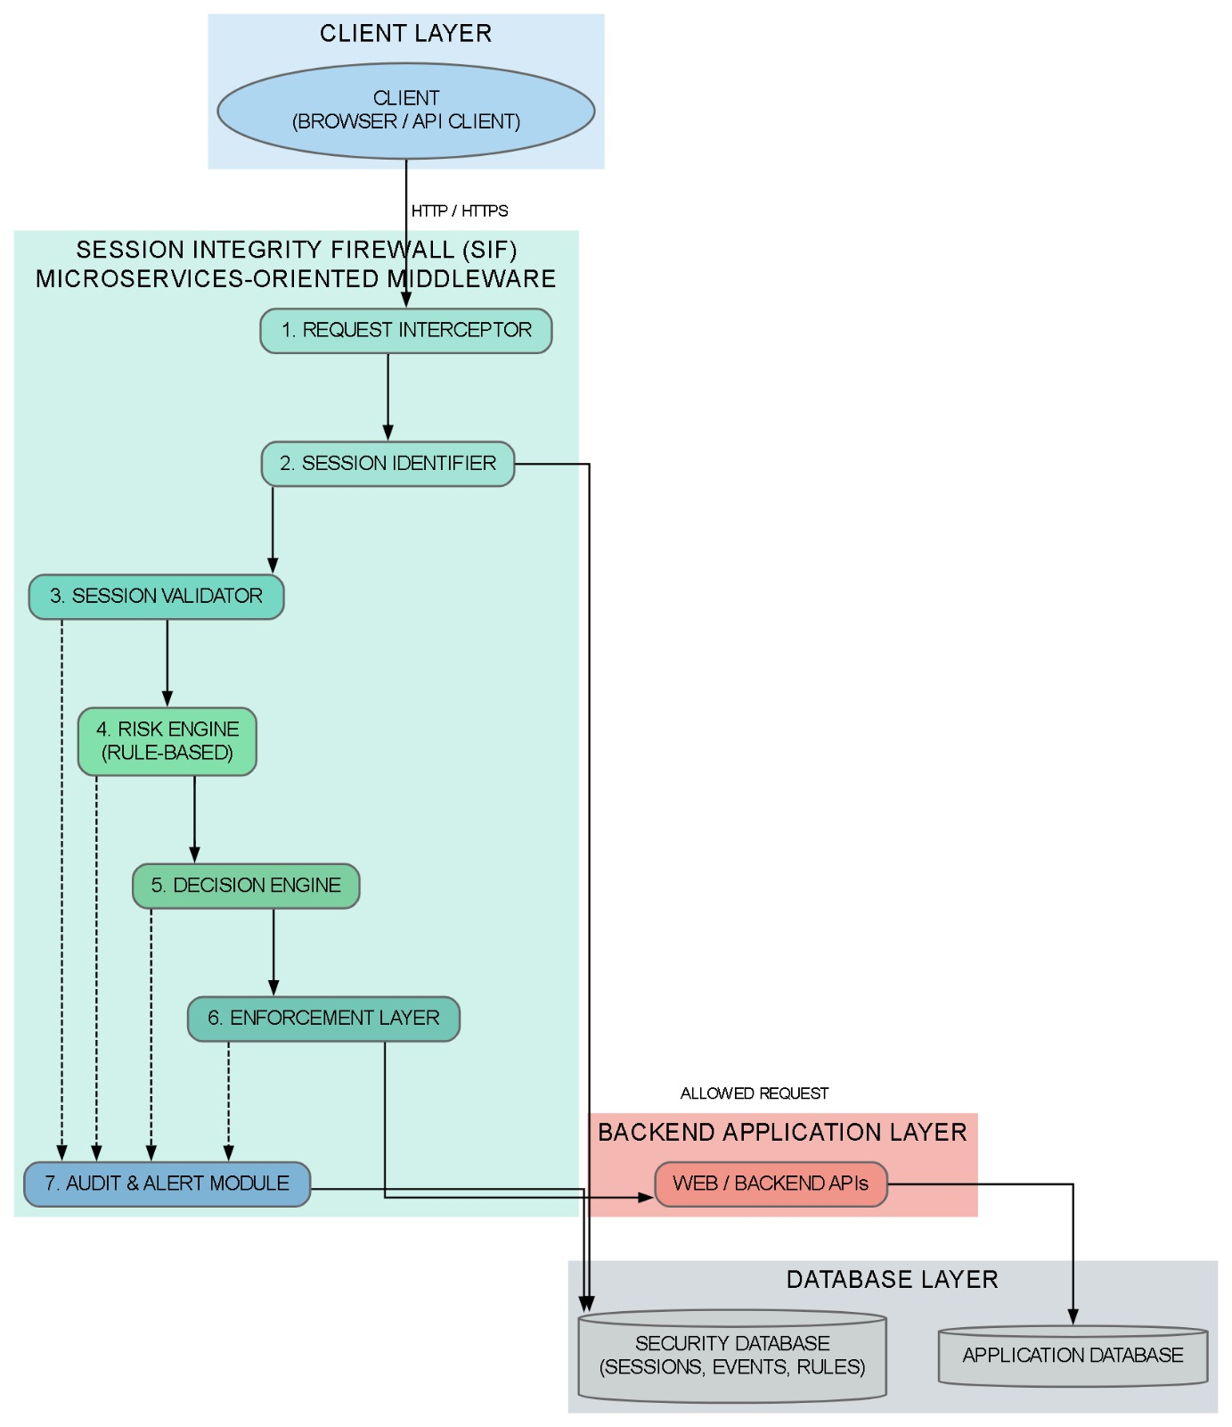
Architecture/ Block Diagram

Slide 13
SDG Mapping
SDG 9 – Industry, Innovation & Infrastructure
Strengthens digital infrastructure security through continuous session protection
Encourages innovation in application-layer cybersecurity solutions
SDG 16 – Peace, Justice & Strong Institutions
Protects organizational and user data from session-based attacks
Prevents unauthorized digital access and account takeover
SDG 8 – Decent Work & Economic Growth
Reduces financial losses caused by data breaches and account compromise
Supports secure digital business environments and user trust

Slide 14
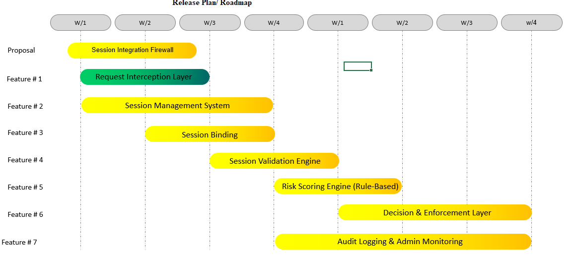
Release plan / Timeline

Slide 15
Abstract
Modern web applications typically rely on single-point authentication, where users are trusted after login through tokens like JWTs or cookies. This model creates security risks when tokens are stolen or misused, enabling attacks such as session hijacking and replay. The proposed Session Integrity Firewall (SIF) introduces continuous session validation by binding tokens to contextual attributes like IP address, User-Agent, and device fingerprint while analyzing behavior through a rule-based risk engine. Based on calculated risk, the system enforces actions such as step-up authentication, session termination, or IP blocking. With a modular and AI-ready design, SIF strengthens session security without requiring changes to existing authentication frameworks.

Slide 16
References
Popov, A., 2018. Nystroem, M., Balfanz, D., and J. Hodges," The Token Binding Protocol Version 1.0. RFC 8471, DOI 10.17487/RFC8471, October 2018,< https://www. rfc-editor. org/info/rfc8471.
Amira, A., Ouadjaout, A., Derhab, A. and Badache, N., 2017, March. Sound and static analysis of session fixation vulnerabilities in php web applications. In Proceedings of the Seventh ACM on Conference on Data and Application Security and Privacy (pp. 139-141).
Dacosta, I., Chakradeo, S., Ahamad, M. and Traynor, P., 2012. One-time cookies: Preventing session hijacking attacks with stateless authentication tokens. ACM Transactions on Internet Technology (TOIT), 12(1), pp.1-24.
Baig AF, Eskeland S. Security, Privacy, and Usability in Continuous Authentication: A Survey. Sensors (Basel). 2021 Sep 6;21(17):5967. doi: 10.3390/s21175967. PMID: 34502865; PMCID: PMC8434648.
Abu Bakar, Khairul Azmi & Haron, Galoh. (2014). Adaptive authentication based on analysis of user behavior. Proceedings of 2014 Science and Information Conference, SAI 2014. 601-606. 10.1109/SAI.2014.6918248.
Picard, Claudy & Pierre, Samuel. (2023). RLAuth: A Risk-Based Authentication System Using Reinforcement Learning. IEEE Access. PP. 1-1. 10.1109/ACCESS.2023.3286376.

Slide 17
References
Wang X, Shi Y, Zheng K, Zhang Y, Hong W, Cao S. User Authentication Method Based on Keystroke Dynamics and Mouse Dynamics with Scene-Irrelated Features in Hybrid Scenes. Sensors (Basel). 2022 Sep 1;22(17):6627. doi: 10.3390/s22176627. PMID: 36081085; PMCID: PMC9460698.
Mondal, Soumik & Bours, Patrick. (2016). A study on Continuous Authentication using a combination of Keystroke and Mouse Biometrics. Neurocomputing. 230. 10.1016/j.neucom.2016.11.031.
Baitha, A.K. and Vinod, S., 2018. Session hijacking and prevention technique. Int. J. Eng. Technol, 7(2.6), pp.193-198.
Dalimunthe, Syabdan & Putra, Emansa & Ridha, Muhammad. (2023). Restful API Security Using JSON Web Token (JWT) With HMAC-Sha512 Algorithm in Session Management. IT Journal Research and Development. 8. 81-94. 10.25299/itjrd.2023.12029.

